Slide 1

Dr.Mahalingam College of Engineering & Technology
Department of Artificial Intelligence & Data Science
19ADPN6601 – Innovative and Creative Project
Second Review
Title: AI Based Model for Predicting Agri-horticultural Commodities
Batch Number : 15
Team Name : 23BADA15
Domain : Agriculture / Foodtech
Team Members
1. Sharanya T | (727622BAD007)
2. Santhosh S | (727622BAD073)
3. Aashif Shadin K N | (727622BAD099)
Guide: Mr. M. Viyajakumar, AP/AI&DS

Slide 2
Title
AI Based Model for Predicting Agri-horticultural Commodities

Slide 3
Contents
Introduction
Problem Statement
Literature Identified and Findings
Algorithm used
Proposed Flow Chart
Module Description
Software Requirements
References
Certification

Slide 4
Problem Statement
Agricultural commodity prices are highly volatile and because of this, traditional forecasting models often fail to provide accurate predictions, leading to inefficient buffer stock management and ineffective market interventions. This project leverages deep learning to develop a robust price prediction model that enhances forecasting accuracy while supporting strategic decision-making. By integrating AI-driven real-time data analysis, the solution aims to improve price stability, optimize government interventions, and reduce economic uncertainty in the agricultural sector.

Slide 5
Literatures Identified and Findings
“Agricultural Commodity Price Prediction Model: A Machine Learning Framework”(2023) Manas Kumar Mohanty, Parag Kumar Guha Thakurta, Samarjit Kar
Time Series Algorithms : This paper presents a machine learning framework designed to predict crop prices by integrating factors such as crop yield, supply, and demand. The study employs various time series algorithms and identifies the decision tree regressor as the most effective model for price prediction. The framework aims to assist farmers in making informed decisions regarding their produce by providing accurate price forecasts.

Slide 6
Literatures Identified and Findings
"Forecasting Agricultural Commodity Prices Using Model Selection Framework With Time Series Features and Forecast Horizons" (2020) Dabin Zhang, Shanying Chen, Liwen Ling, Qiang Xia
Model Selection Framework: The study introduces a novel framework that selects the optimal forecasting model based on specific time series features and forecast horizons. This approach tailors the model choice to the unique characteristics of the data and the desired prediction timeframe, enhancing forecasting accuracy. IEEE Xplore

Slide 7
Literatures Identified and Findings
"Forecasting Agricultural Commodity Prices Using Model Selection Framework With Time Series Features and Forecast Horizons" (2020) Dabin Zhang, Shanying Chen, Liwen Ling, Qiang Xia
Feature Reduction: The research employs the Minimum Redundancy Maximum Relevance (MRMR) method to reduce feature redundancy. This technique selects the most informative features, improving the performance of the forecasting models by eliminating irrelevant or redundant data. IEEE Xplore
Integrating these insights can enhance the precision of commodity price predictions by ensuring that the most suitable models and features are utilized for each forecasting scenario.

Slide 8
Algorithms used
1. Data Collection & Preprocessing
Open Government Databases – Collect real-time details of various commodities from agmarknet.gov.in and historical agricultural commodity price data from data.gov.in .
Data Cleaning (Pandas) – Handle missing values, outliers, and inconsistencies.
Feature Engineering – Extract seasonality trends, inflation impact, and market signals.
2. Price Prediction Models
ARIMA– Traditional time series forecasting for baseline comparison.
XGBoost / Random Forest – Enhances predictive accuracy by combining statistical features.

Slide 9
Objective
This project aims to develop an AI-driven agricultural commodity price prediction system that enhances forecasting accuracy and aids in strategic market interventions. By integrating deep learning models with real-time data, the system will analyze historical trends, seasonal patterns, and external market factors to predict price fluctuations. The goal is to provide farmers, traders, and policymakers with data-driven insights for better buffer stock management, price stability, and risk mitigation, ultimately reducing economic uncertainty in the agricultural sector.

Slide 10
Proposed System Flow Chart
Data Integration
Model Building
Data Preprocessing
Trained Model
Time Series Prediction
1. Preprocessing
Raw Data
Input Parsing
2. Prediction
Unseen Data

Slide 11
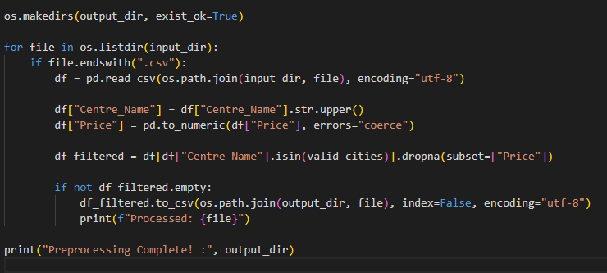
Module Description
1. Data Preprocessing
The script preprocesses CSV files by cleaning and filtering data based on city names and valid price values. The processed data is then saved to an output directory for further analysis.

Slide 12
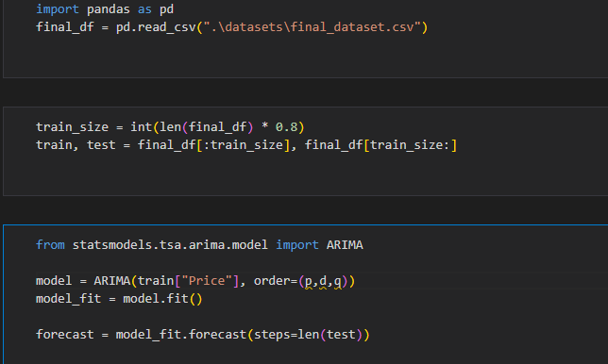
Module Description
2. Model Building
The script loads a dataset, splits it into training and testing sets, and applies the ARIMA model for price forecasting. It trains the model using historical price data and predicts future values.

Slide 13
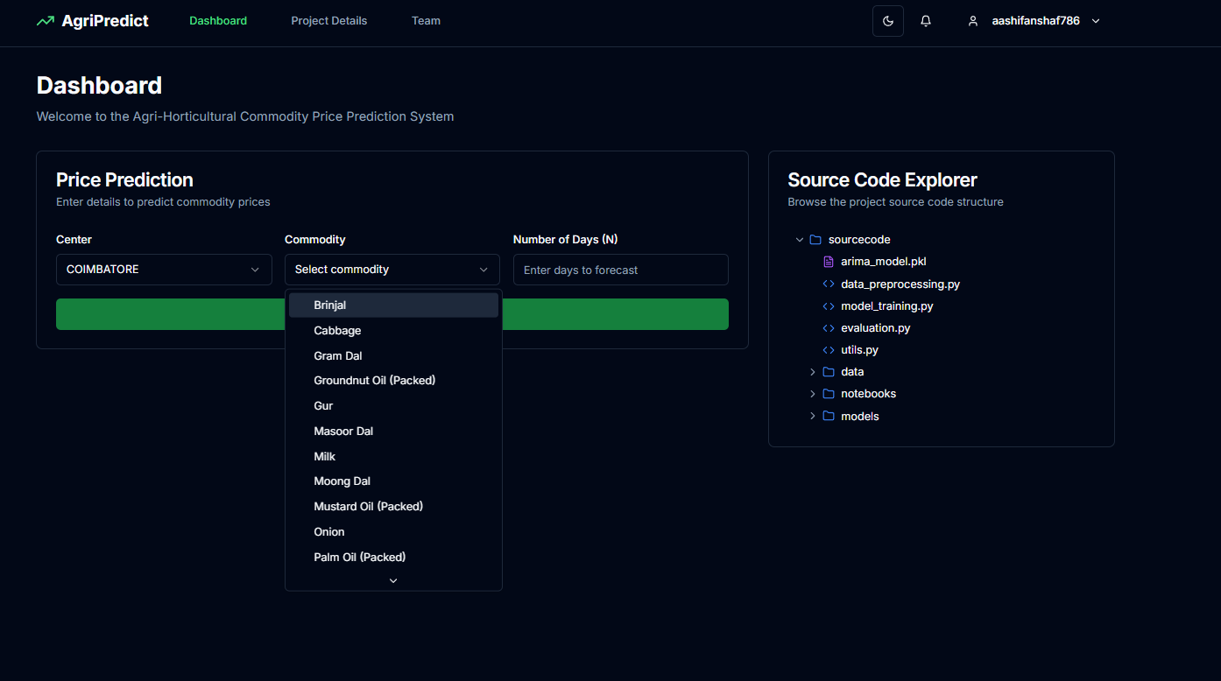
Module Description
3.Frontend

Slide 14
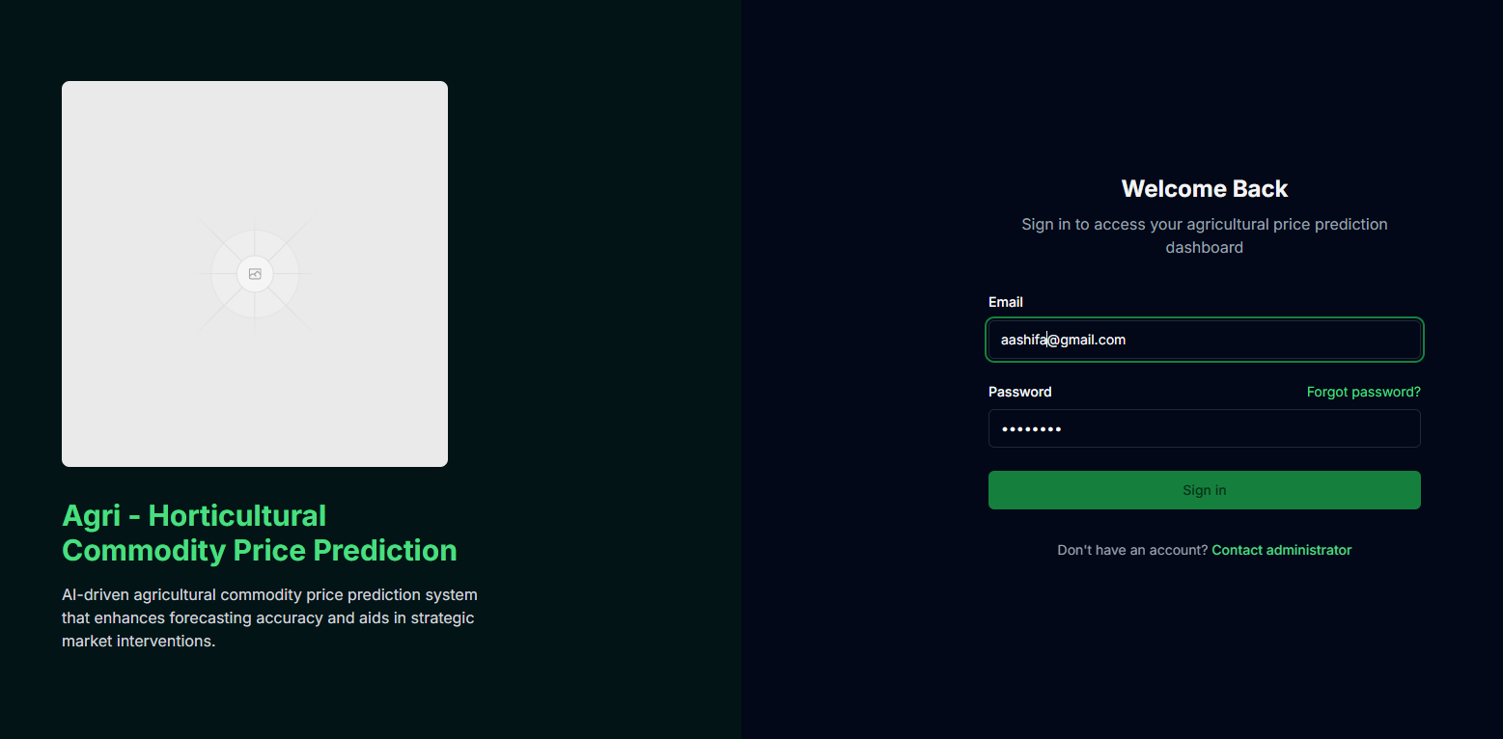
Module Description
3.Frontend
Login Page using for user email and password

Slide 15
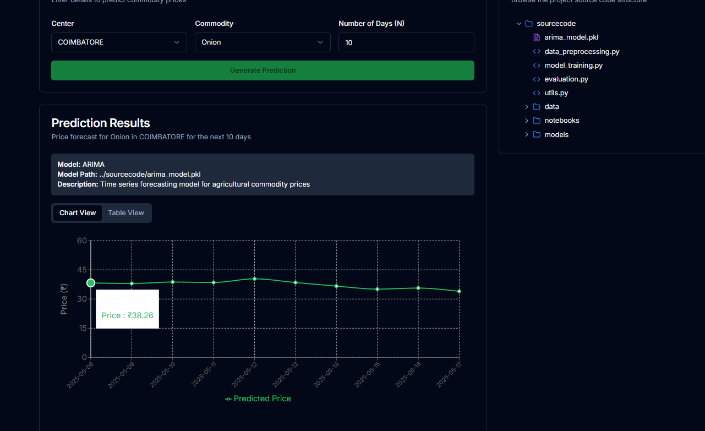
Output
Thus, select crop ,region to predict price of selected crop in selected region

Slide 16
Software Requirements
1. Operating System | Windows 11
2. Programming Languages | Python (Pandas, NumPy, Sklearn, TensorFlow/PyTorch)
3. Data Processing | MS Excel, Pandas
4. ML/DL Frameworks | Scikit-learn, TensorFlow, PyTorch, Statsmodels (for ARIMA)

Slide 17
References
Artificial Intelligence Technology in the Agricultural Sector: A Systematic Literature Review (2022) Ersin Elbasi, Nour Mostafa, Zakwan Alarnaout, et al., IEEE
AgTech: Volatility Prediction for Agricultural Commodity Exchange Trading Applied Deep Learning (2024) Ngoc-Bao-Van Le, Yeong-Seok Seo, Jun-Ho Huh, IEEE
Forecasting Agricultural Commodity Prices Using Model Selection Framework With Time Series Features and Forecast Horizons (2020) Dabin Zhang, Shanying Chen, Liwen Ling, Qiang Xia, IEEE

Slide 18
Course Completion
Student Name | Course Title | Plateform | Status
Sharanya T | Machine Learning & AI | PrepInsta Prime | 100% completed
Santhosh S | Machine Learning & AI | PrepInsta Prime | 100% completed
Aashif Shadin K N | Machine Learning & AI | PrepInsta Prime | 100% completed

Slide 19

Certificate

Slide 20

Certificate

Slide 21

Certificate

Slide 22


